Slide 1


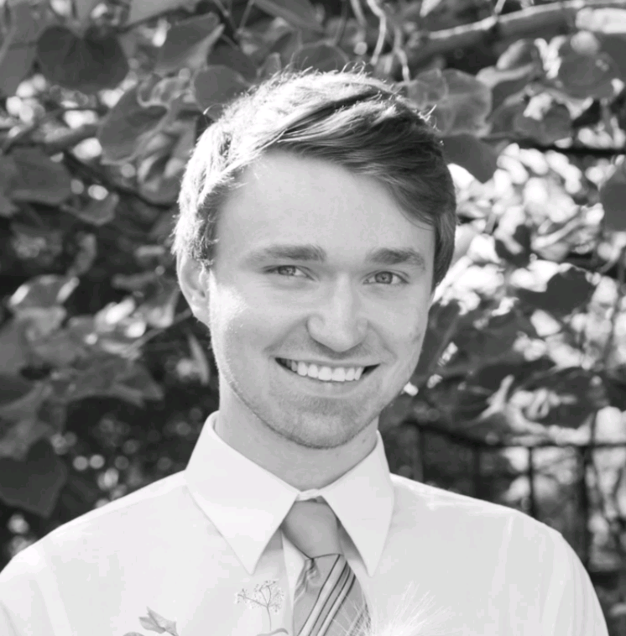
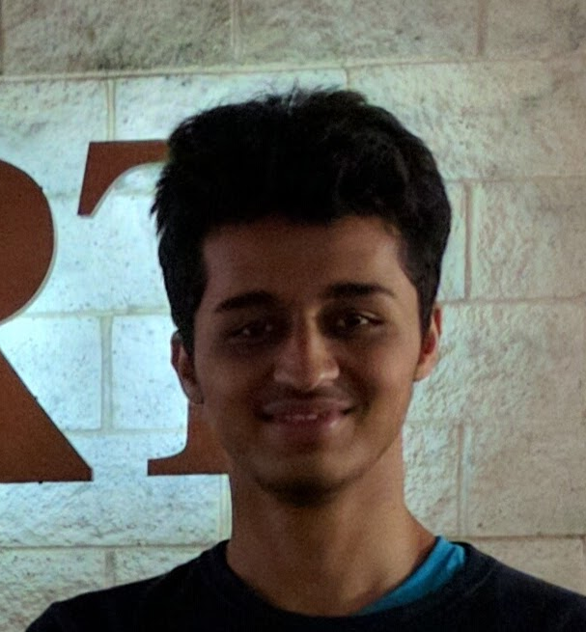






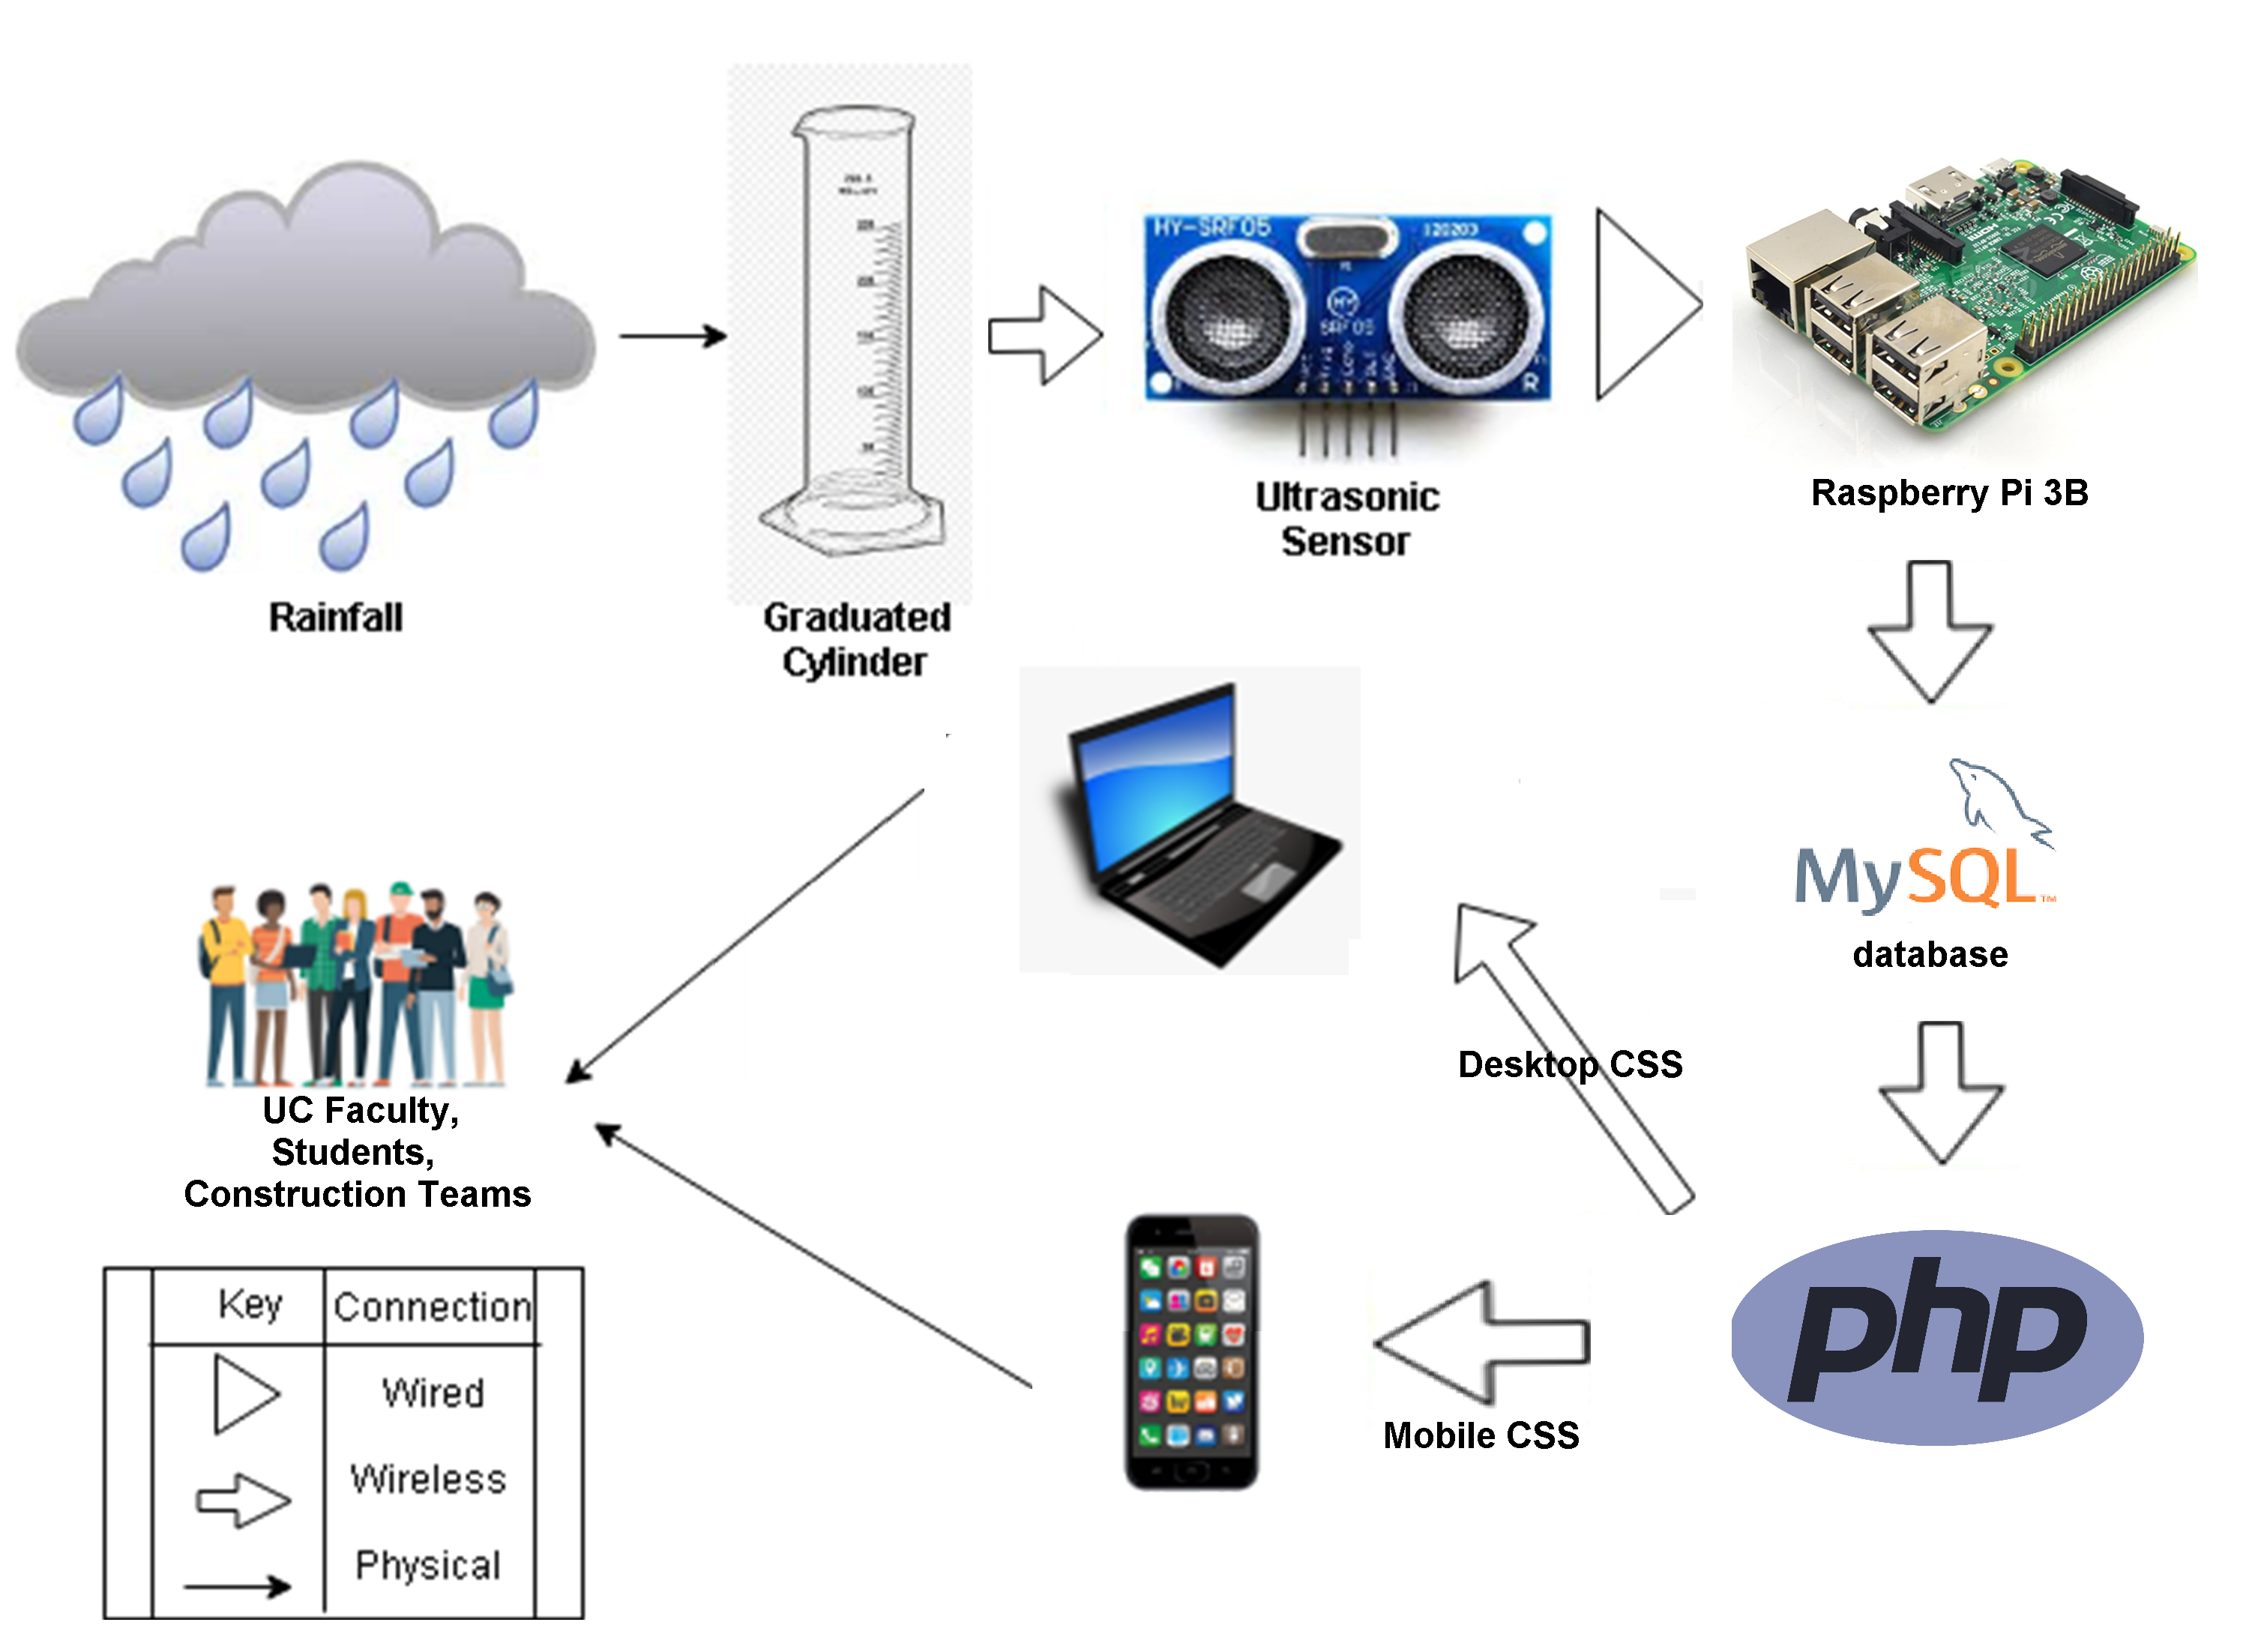
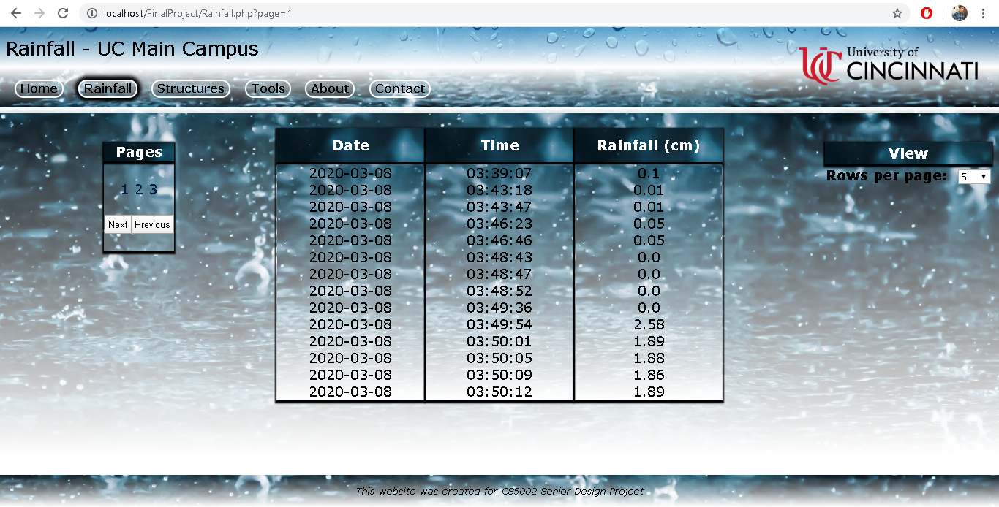
Problem
UC Rainfall Analysis
Challenges
Advisor: Fred Annexstein
-Security: will the sensor be broken if left on campus?
-Legal: are we allowed to place a rainfall sensor on campus?
-Technical: how do we display rainfall data in a way that it’s visible to anyone, anywhere?
Currently, there is not an accurate way to determine the amount of rainfall and erosion experienced by structures on UC’s campus. There is also a lack of equipment we can use to determine the prediction on a simpler scale.
Smit Patel
Jessica Doyal
Collin Fox
Prathamesh Brahmankar
Solution
Development
Future Plans
Rainfall levels can be logged with high precision using an ultrasonic sensor and a Raspberry Pi. Because of their portability, we can analyze rainfall occurring on specific UC buildings. This will hopefully bring an accurate measuring system that is user friendly to all the faculty and students at UC.
Distance readings from the ultrasonic sensor are captured using the raspberry pi via python. Our python code then inserts the sensor readings into a MySQL database, which is displayed on a webpage using a combination of PHP and CSS.
-Enhance user experience via new features
-Expand to more college campuses and communities
-Apply CSS themes to a mobile app available in the Google Play Store and Apple App Store
Design Plan
User Interface

